Slide 1

Crop Production Analysis (2000-2015)
-Shraddha Sharma

Slide 2
KPI’s
TOTAL AREA - The total area under cultivation sums up to 2,953,786,189 hectares .
TOTAL PRODUCTION - The total production achieved stands at 141,176,116,767 hectares .
TOTAL CROPS - We have data on 124 different crops cultivated across the seasons of Kharif, Rabi, Summer, Winter, and Autumn.

Slide 3
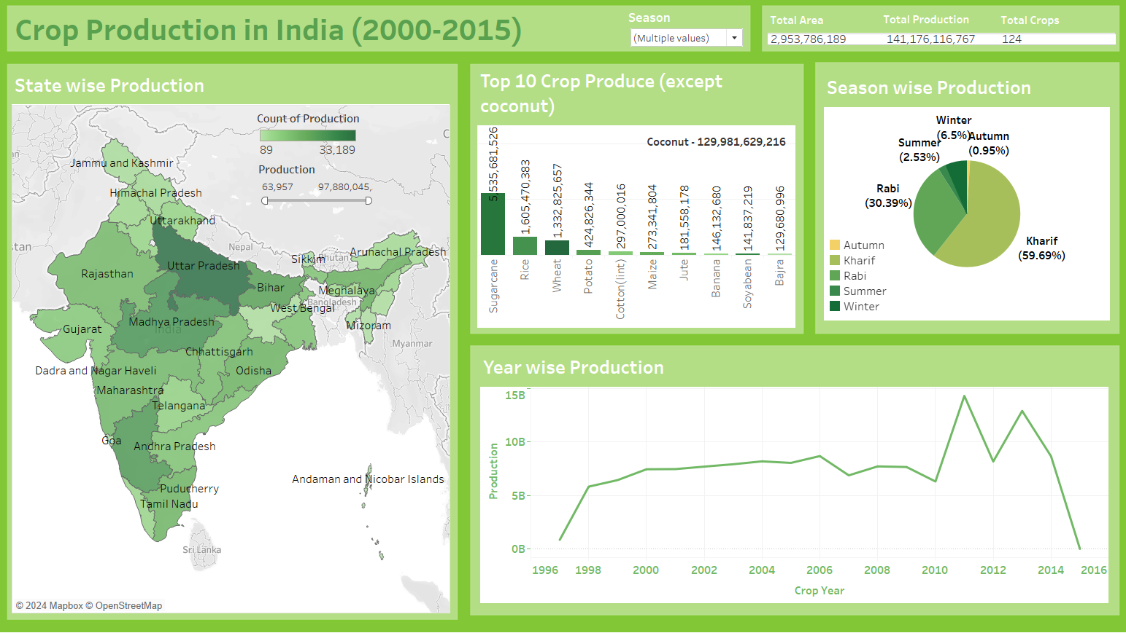
DASHBOARD

Slide 4
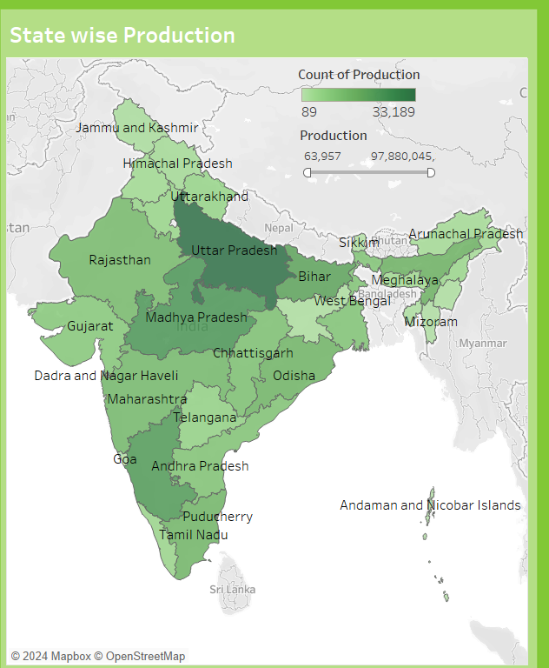
STATE WISE PRODUCTION

Slide 5
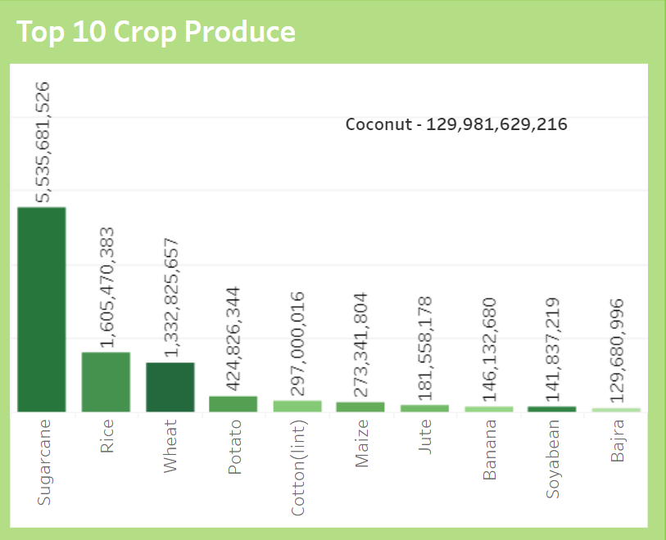
TOP CROP PRODUCED

Slide 6
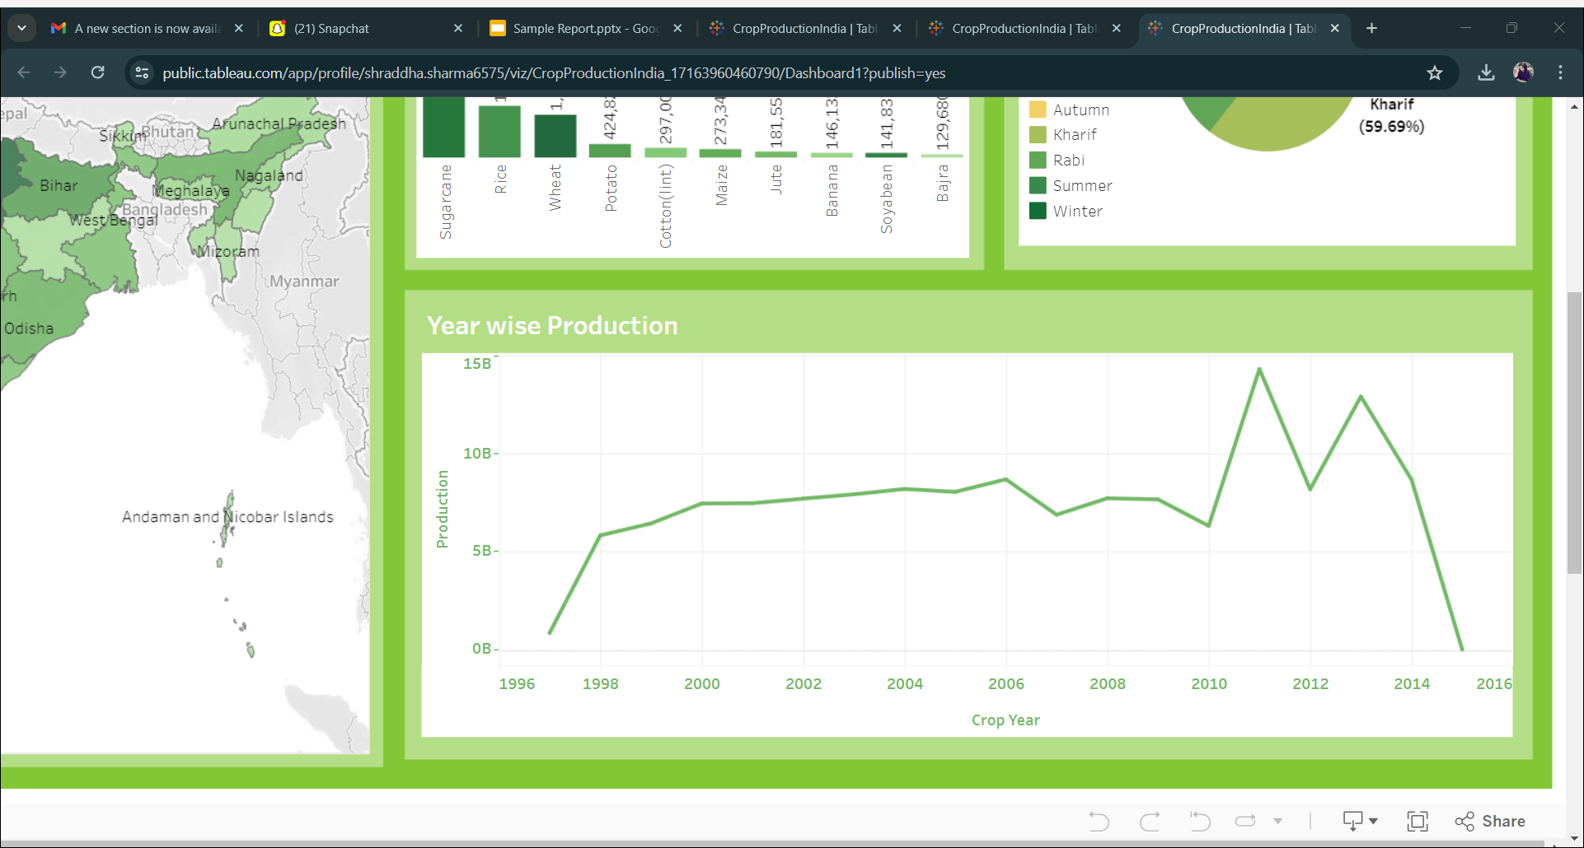
YEAR WISE PRODUCTION

Slide 7

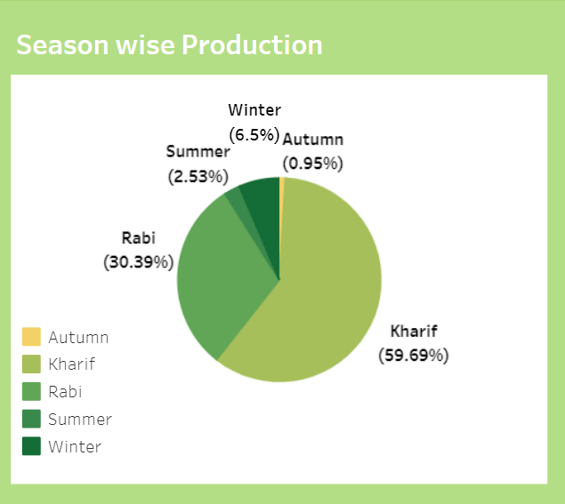
SEASON WISE PRODUCTION

Slide 8

ANALYSIS
STATE PRODUCING MAXIMUM CROP - Uttar Pradesh emerged as the top producer with a substantial production count of 33,189
The leading crop is coconut with a production of 129,981,629,216 units. Following coconut, sugarcane and rice takes the spot with a significant production .
Kharif season stands out as the top performer, contributing to 59.69% of the total production.
In the train chart displaying production over the years from 2000 to 2015, it's evident that the highest production was recorded in the year 2011, reaching 143,089,04087 units. Following closely, the second-highest production occurred in 2013, with a production of 12,903,588,633 units.

Slide 9

THANK YOU

